Slide 1
DESIGN, FABRICATION AND TESTING OF A MINI FREEZE DRYER.
GROUP 10A
BSc. MECHANICAL ENGINEERING
MR. P. O. TAWIAH

Slide 2
Outline of Presentation
INTRODUCTION/PROJECT BACKGROUND
PROBLEM STATEMENT
AIM AND SPECIFIC OBJECTIVES
LITERATURE REVIEW
CONCEPTUAL DESIGNS
DESIGN CALCULATIONS
FABRICATION, ASSEMBLY & TESTING
CONCLUSION
RECOMMENDATION

Slide 3
INTRODUCTION/ PROJECT BACKGROUND
• Freeze drying removes moisture via sublimation under low temperature and pressure. (Wikipedia, 2025; Ruiton, 2021)
• Preserves food quality, nutrition, and shelf life.

Slide 4
PROJECT BACKGROUND
Historical Development & Evolution
Ancient civilizations, like the Peruvian Incas and Aymara people, practiced early freeze-drying technique. (FamilyCanning, n.d.; ChinaFreezedried, 2024)
Freeze-drying became crucial during WWII for medical supplies and blood storage. (NewLifeScientific, 2023; FamilyCanning, n.d.).
Post-war, Nestlé developed freeze-dried coffee, and NASA used the technology for astronaut food in the 1960s. (FreezeDriedExpert, 2024; ChinaFreezedried, 2024).
Modern Trends
Today, freeze drying is used in pharmaceuticals, biotechnology, and food industries. Advancements include improved vacuum systems, refrigeration, and pre-treatments like infrared heating. (Barnalab, 2023; FreezeDriedExpert, 2024).

Slide 5
PROBLEM STATEMENT
Food spoilage leads to waste, financial loss and food insecurity.

Slide 6
AIM AND SPECIFIC OBJECTIVES
AIM
THE DESIGN, FABRICATION AND TESTING OF A MINI FREEZE DRYER.
SPECIFIC OBJECTIVES
TO CONDUCT LITERATURE REVIEW ON FREEZE DRYERS AND FREEZE-DRYING PROCESS.
TO DEVELOP AND EVALUATE DESIGN CONCEPTS.
TO CONSTRUCT THE FREEZE DRYER AND TO TESTING OF THE FREEZE DRYER.

Slide 7
LITERATURE REVIEW
Characteristics of freeze-dried products
Weight reduction. (Wikipedia, 2025; EREA, 2024).
Extended shelf life. (Wikipedia, 2025; EREA, 2024).
Preservation of nutrients. (FamilyCanning, n.d.; Barnalab, 2023).
Rehydration capability. (Wikipedia, 2025; EREA, 2024).
Freeze-Drying process
Freezing. (Wikipedia, 2025).
Primary drying. (Wikipedia, 2025).
Secondary drying. (Wikipedia, 2025).

Slide 8
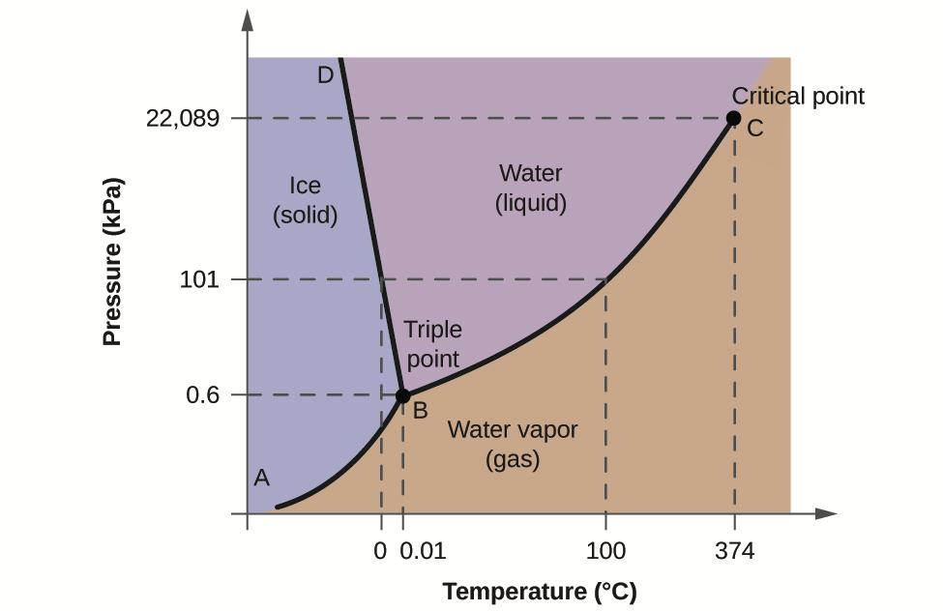
LITERATURE REVIEW
PHASE CHANGE DIAGRAM FOR WATER

Slide 9
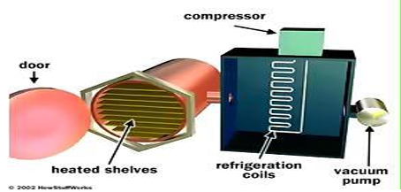
LITERATURE REVIEW
Basic components of a freeze dryer
Refrigeration system (UKessays, 2023).
Vacuum system (UKessays, 2023).
Heating System (UKessays, 2023).

Slide 10
CONCEPTUAL DESIGN
Functional requirement
The system must be able to freeze dry products in a single cycle.
The Vacuum chamber must be airtight, thermally insulated and withstand vacuum pressure without deformation.
Components in contact with food must be food safe, non-reactive, and resistant to low temperature and vacuum conditions.
The vacuum pump must be able to reduce chamber pressure below 0.6kPa
The freezing system must cool the chamber to -30°C or lower to freeze the food before drying.
The system must provide controlled and evenly distributed heating up to 60°C to facilitate sublimation without cooking the food.

Slide 11
CONCEPTUAL DESIGN
Design requirements
Size.
Material.
Cost.
Manufacturing feasibility.
Assembly.
Availability of components.
Transport.

Slide 12
EVALUATION CRITERIA
PARAMETERS
Cost
Time to build
Energy efficiency
Ease of maintenance
Capacity
Technical Feasibility
Material Selection

Slide 13
DECISION MATRIX TABLE
Criteria | Weight (%) | Concept 1 (Score 1-10) | Weighted Score | Concept 2 (Score 1-10) | Weighted Score | Concept 3 (Score 1-10) | Weighted Score | Comments
Cost | 15% | 7 | 1.05 | 8 | 1.20 | 6 | 0.90 | Concept 1 is the most affordable, but Concept 2 offers better value.
Time to Build | 10% | 8 | 0.80 | 7 | 0.70 | 6 | 0.60 | Concept 1 is the fastest to build due to its simpler assembly.
Energy Efficiency | 20% | 7 | 1.40 | 9 | 1.80 | 6 | 1.20 | Concept 2 has the best insulation and optimized energy use.

Slide 14
DECISION MATRIX TABLE
Ease of Maintenance | 10% | 5 | 0.50 | 8 | 0.80 | 7 | 0.70 | Concept 2 has modular components, while Concept 3 is also fairly easy to maintain.
Capacity | 15% | 6 | 0.90 | 8 | 1.20 | 7 | 1.05 | Concept 2 has the highest batch size, while Concept 3 is still competitive.
Technical Feasibility | 10% | 7 | 0.70 | 8 | 0.80 | 6 | 0.60 | Concept 1 is easier to manufacture, but Concept 2 is more technically advanced.
Material Selection | 10% | 8 | 0.80 | 9 | 0.90 | 7 | 0.70 | Concept 1 and Concept 2 use strong, durable materials.

Slide 15
DECISION MATRIX TABLE
Safety | 10% | 6 | 0.60 | 9 | 0.90 | 8 | 0.80 | Concept 2 has superior safety features, but Concept 3 also has good structural integrity.
Total Score | 100% | 6.75 |  | 8.30 |  | 6.55 |  | Concept 2 is the most balanced and efficient choice.

Slide 16
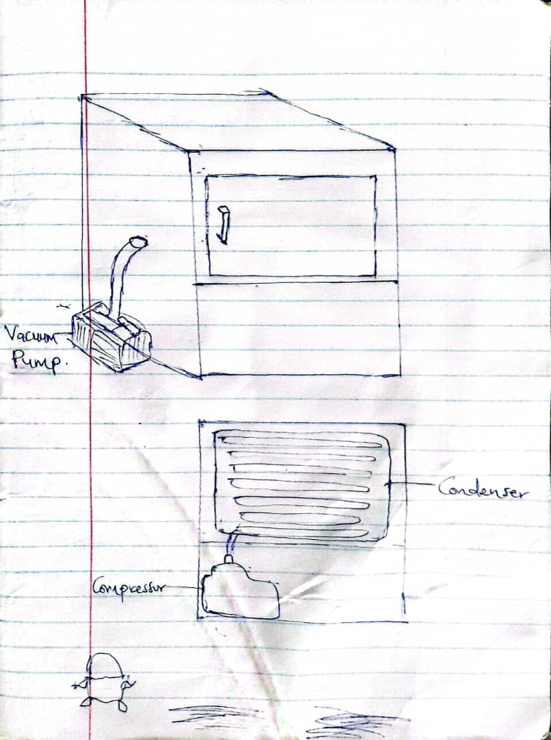
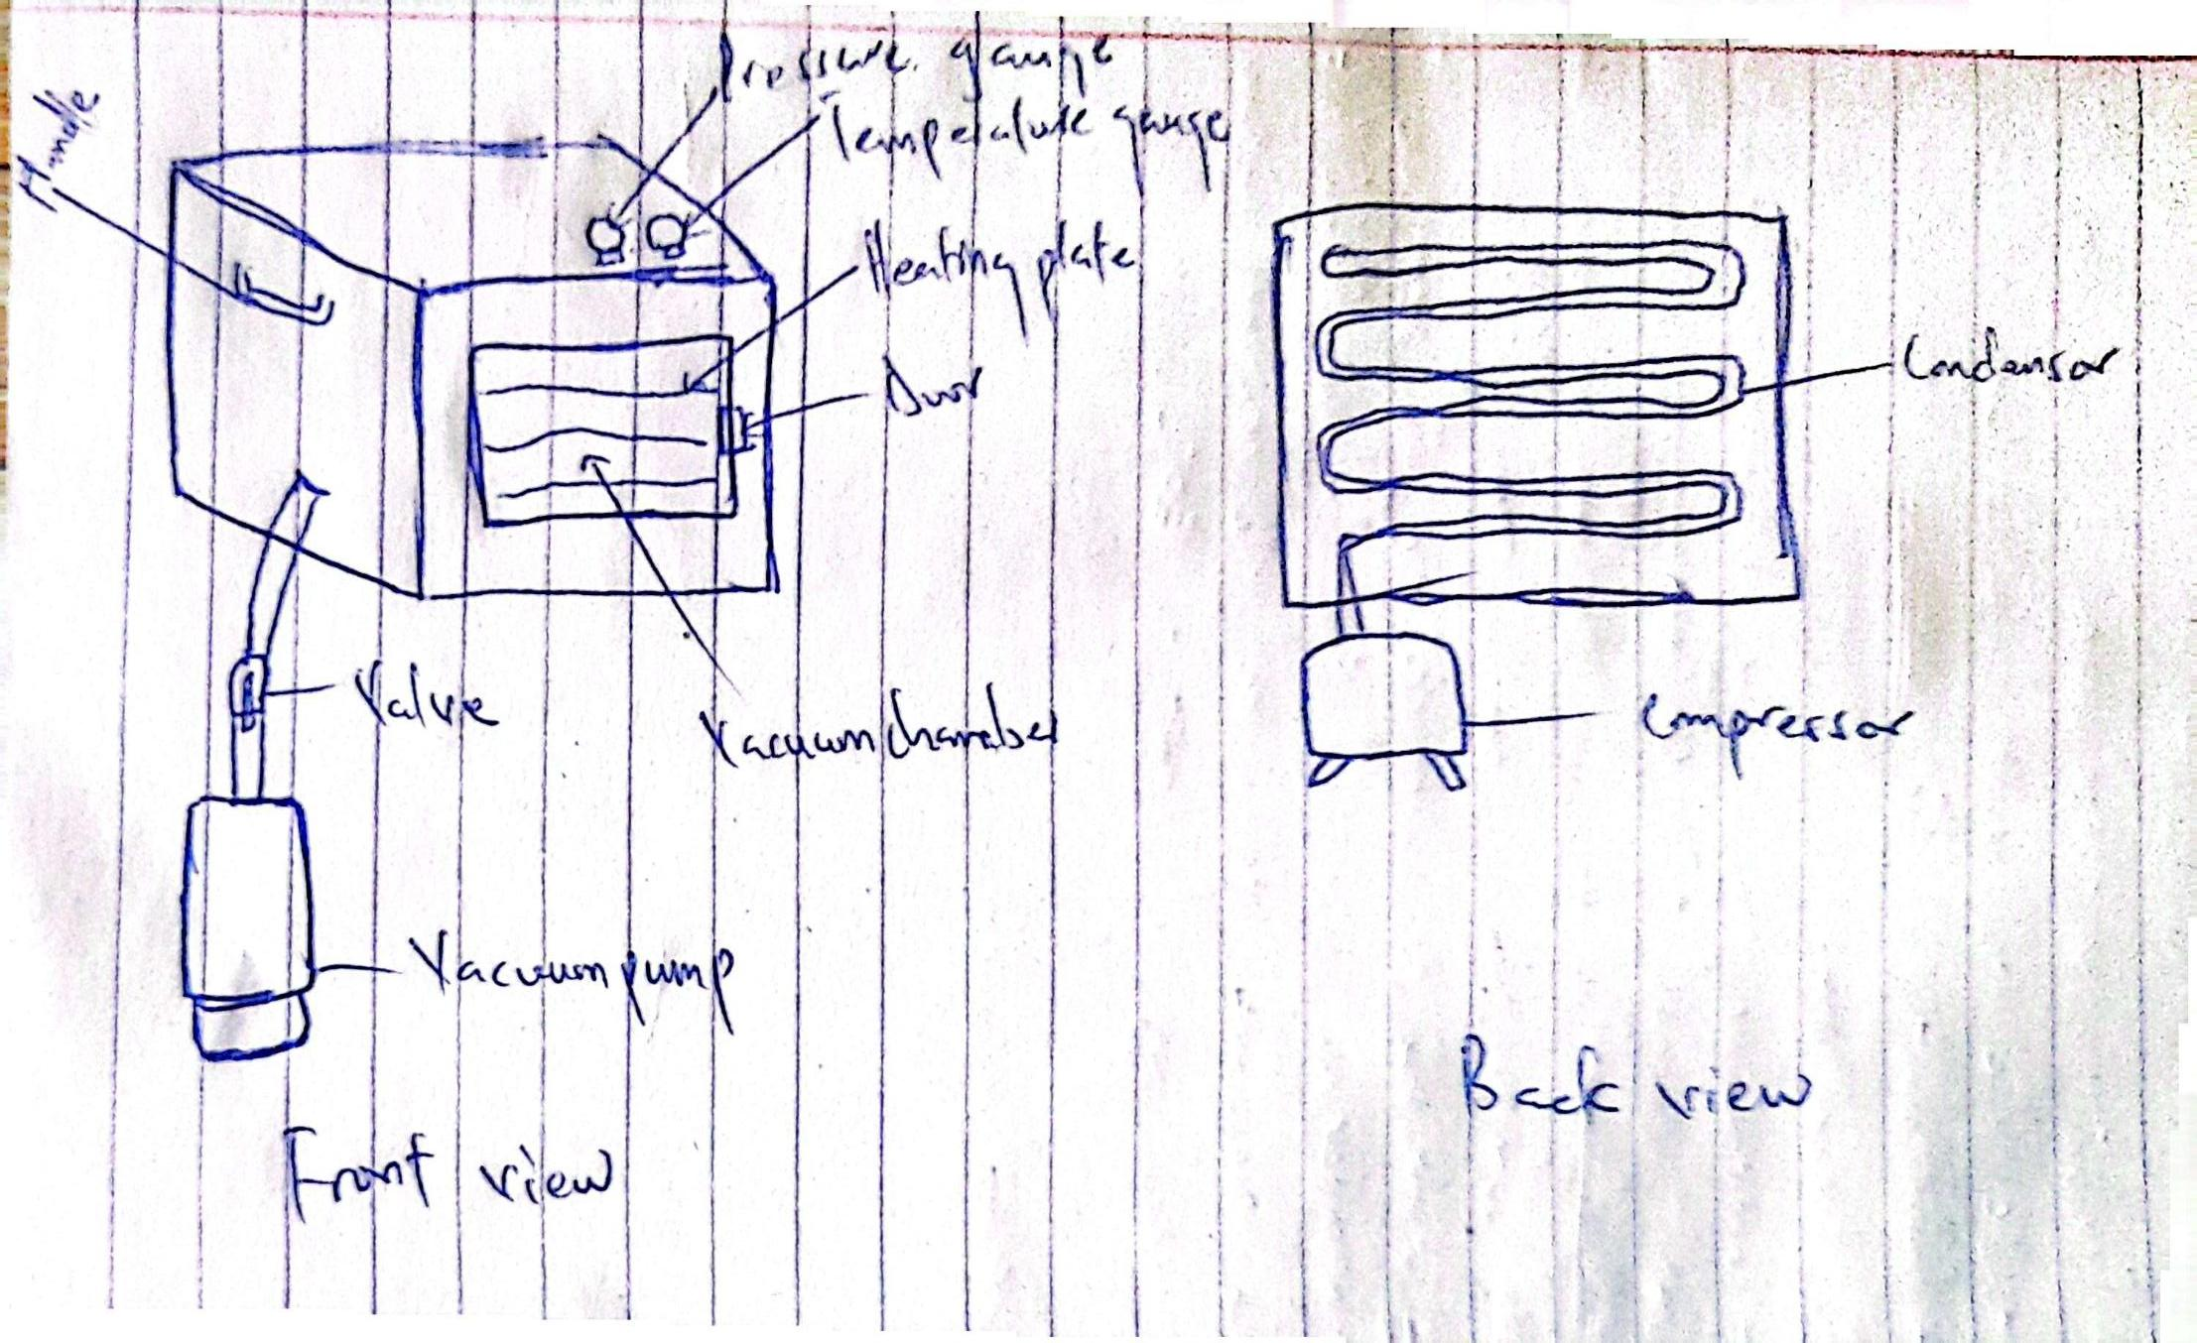
CONCEPTUAL DESIGN
CONCEPT 1
CONCEPT 2

Slide 17
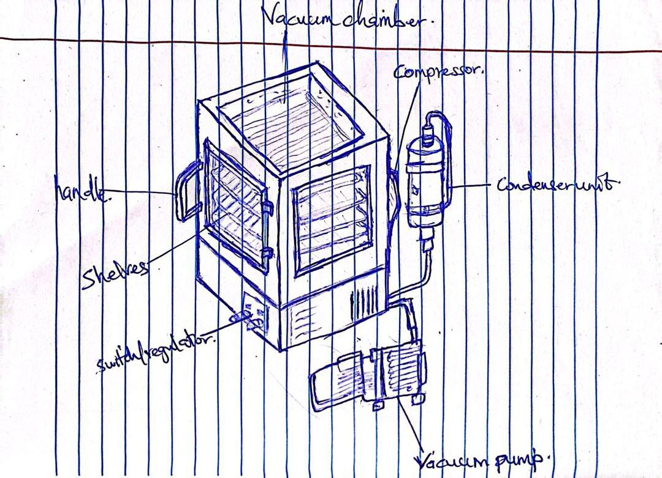
CONCEPTUAL DESIGN
CONCEPT 3

Slide 18
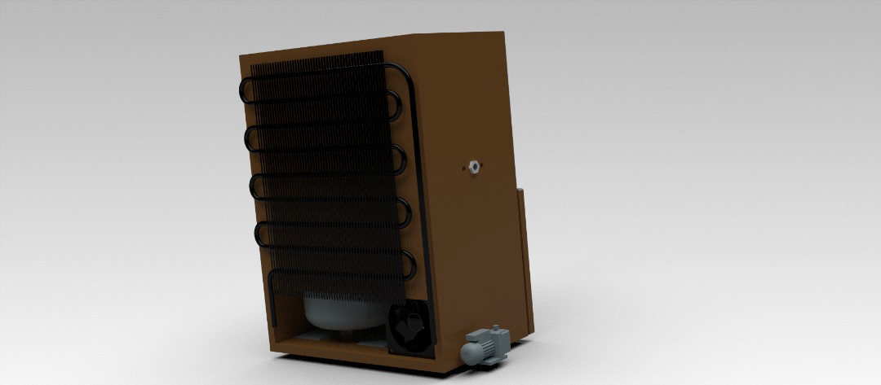
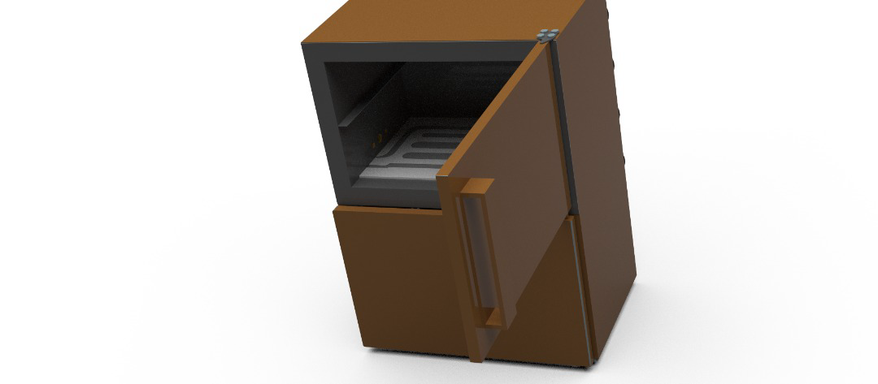
FINAL CONCEPT

Slide 19
EXPLODED VIEW

Slide 20
DESIGN CALCULATIONS
Design specification
PARAMETERS | VALUE
MASS OF PRODUCT (m) | 400g of chicken breast
INITIAL TEMPERATURE (T1) | 25 ⁰C
FREEZING TEMREATURE | -30 ⁰C
DRYING TIME | 12 HOURS
REFRIGERANT | R600a
INSULATION | 1.5cm of polyurethane and 2cm of plywood
CHAMBER DIMENSIONS | 560 mm × 370 mm × 380 mm
AMBIENT TEMPERATURE | 25 ⁰C
Calculate Cooling Load
Freezing Load
Total energy required to freeze 0.4 kg of food from 25°C to -30°C.

Slide 21
DESIGN CALCULATIONS
Parameters:
m = 0.4 kg
cp (fresh) = 3.2 kJ/kg·K
cp (frozen) = 1.6 kJ/kg·K
h_fus = 235 kJ/kg
T1 = 25°C, T2 = -30°C
Formulas Used:
Sensible Cooling: Q = m · cp · ΔT
Latent Heat: Q = m · h_fus
Calculations:
From 25°C → 0°C: Q1 = 0.4 × 3.2 × 25 = 32.0 kJ
Phase change: Q2 = 0.4 × 235 = 94 kJ
From 0°C → -30°C: Q3 = 0.4 × 1.6 × 30 = 19.2 kJ
Total Freezing Load: Q_freeze = 32.0 + 94 + 19.2 = 145.2 kJ

Slide 22

DESIGN CALCULATION
Average Freezing Power: Total freezing load = $\frac{145.2}{3600}$ =40.33W
Sublimation Load
Assuming chicken breast contains 75% of water, 400g = 0.3 kg of water
Energy required to sublimate 0.3 kg of water in 12 hours.
Parameters:
m_water = 0.3 kg
t(time) = 12 × 3600 = 43200 s
h_sub = 2840 kJ/kg
Formulas:
ṁ _water = m_water / t
Q = ṁ × h_sub
Calculations:
ṁ = 0.3 / 43200 = 6.94 × 10⁻⁶ kg/s
Q_subl = 6.94 × 10⁻⁶ × 2840 = 19.71 W

Slide 23
DESIGN CALCULATION
Heat Leakage
The heat gain in freezer is due to heat transfer through walls(door, right wall, left wall behind wall , bottom wall, upper wall)
Q wall = U*A*(Tout - Tin)
Where :
A: outside surface area of the wall [m2]
U: the overall heat transfer coefficient [𝑊/𝑚2.℃]
Ain: inside area for chamber
Aout: outside area for chamber
tin : temperature in side refrigerator = -30℃
tout : ambient temperature = 25℃
Parameters:
hi(convection heat transfer coefficient of air inside)= 5 W/m²K (conservative value)
ho(convection heat transfer coefficient of air outside)= 10 W/m²K (standard upper end estimation)
t1(thickness of aluminum plate)= 0.002 m
k1(thermal conductivity of aluminum plate) = 237 W/mK
t2(thickness of polyurethane foam)= 0.015 m
k2(thermal conductivity of polyurethane foam)= 0.03 W/mK

Slide 24
DESIGN CALCULATION
t3(thickness of plywood)= 0.02 m
k3(thermal conductivity of plywood)= 0.13 W/mK
Formula used
U= 1/(1/h1 + t1/k1 + t2/k2 + t3/k3 + 1/ho)
U = 1/(1/5 + 0.002/237 + 0.015/0.03 + 0.02/0.13 + 1/10)
U = 1.048 W/m²K
Heat leakage
Chamber size= 560mm*370mm*360mm
Q wall door and back
Q Wall door and back =2*U*A*∆ 𝑇
Q wall door and back= 2*1.048*(0.56*0.36) *55
Q wall door and back= 23.24 W
Q From left and right:
Q left and right =2*U*A*∆ 𝑇
Q left and right = 2*1.048*(0.37*0.36) *55
Q left and right= 15.3 W

Slide 25
DESIGN CALCULATION
Q from upper wall and lower wall:
Q upper and lower wall =2*U*A*∆ 𝑇
Q upper and lower wall =2* 1.048*(0.56*0.37) *55
Q upper and lower wall = 23.82 W
Total heat leakage= 23.24 + 15.3 + 23.82 = 62.36 W
Total cooling load= Freezing load + sublimation load + Heat leakage = 40.33 +19.71 + 62.36 = 122.4 W
With a 20% safety factor to account for variations in ambient temperature, equipment inefficiencies, door opennings or heat infiltration, total cooling load= 20% of 122.4 + 122.4 = 146.88 W
Compressor sizing
Refrigeration capacity (cooling load): Q_L = 146.88 W - Evaporator temperature: T_evap = -40°C - Ambient (condenser) temperature: T_cond = 35°C - Refrigerant: R600a

Slide 26
# Calculation (R‑600a, T_evap = -40°C, T_cond = 35°C) **Assumptions** - Use the R‑600a tables you provided. - Evaporator state (1) is saturated vapor at −40°C. Condenser outlet (3) is saturated liquid at 35°C, and throttling is isenthalpic so h4 = h3. - Compressor isentropic efficiency η_c = 0.80 (common engineering assumption). If you want a different η_c I can redo the numbers. ## 1) Read table values (from your PDF) - h1 (saturated vapor at −40°C): 501.349 kJ/kg. Entropy at this state s1 = 2.323 kJ/kg·K. - h3 (saturated liquid at 35°C): 283.672 kJ/kg → therefore h4 = h3 = 283.672 kJ/kg. ## 2) Find ideal compressor outlet h2s (isentropic) - At condenser pressure (saturation at 35°C) the saturated‑vapor entropy is s_sat,35 = 2.317 kJ/kg·K and at 5 K superheat s ≈ 2.347 kJ/kg·K. To reach s1 = 2.323 at the condenser pressure we need ≈ 1 °C superheat (interpolation). - Interpolating enthalpy at 35°C: h_35,0 = 601.207 kJ/kg (0 K superheat) and h_35,5 = 610.614 kJ/kg (5 K superheat). Interpolating to 1 K superheat gives: h2s ≈ 603.088 kJ/kg.

Slide 27
Real compressor outlet h2 (with η_c = 0.80) h2 = h1 + (h2s − h1) / η_c = 501.349 + (603.088 − 501.349) / 0.80 ≈ 628.523 kJ/kg.
Refrigeration effect and COP q_L = h1 − h4 = 501.349 − 283.672 = 217.677 kJ/kg. w_comp = h2 − h1 = 628.523 − 501.349 = 127.174 kJ/kg. COP = q_L / w_comp = 217.677 / 127.174 ≈ 1.71.
W_c = Q_L / COP = 146.88 / 1.71 ≈ 85.89 W
With 20 % safety factor, 20% * 85.89 + 85.89 = 103.0689W
Condender sizing
Q_cond= Q_comp +Q_evap = 146.88 + 103.0689 = 249.8689 W

Slide 28
Evaporator Size Calculation
Objective: To calculate the required surface area of the evaporator to absorb the total cooling load of 259.27 W at the evaporator’s operating temperature of –45°C.
Formula Used:
Q = U × A × ΔT => A = Q / (U × ΔT)
Given Parameters:
Cooling Load (Q) = 259.27 W
Overall Heat Transfer Coefficient (U) = 250 W/m²·K
ΔT = 10°C (from evaporator temp –45°C to product temp –35°C)
Calculation:
A = 259.27 / (250 × 10) = 0.1037 m²
Recommended Evaporator Area:
A_evap ≈ 0.10 m²

Slide 29
DESIGN CALCULATION
R410A States:
1: Superheated vapor, -50°C, 338.0 kJ/kg
2: Compressed vapor, 75°C, 410.3 kJ/kg
3: Saturated liquid, 50°C, 160.0 kJ/kg
4: Throttled mixture, -55°C, 160.0 kJ/kg
Refrigeration Effect per kg: q_evap = h1 - h4 = 178.0 kJ/kg
Compressor Work: w_comp = h2 - h1 = 72.3 kJ/kg
Mass Flow Rate: ṁ _ref = Q_total / (q_evap × 1000) = 0.00146 kg/s
Compressor Power: P_comp = ṁ _ref × w_comp = 106 W
Volumetric Flow Rate: V = ṁ × v = 0.000321 m³/s
Condenser Size Calculation
Objective: To calculate the required condenser area to reject both the cooling load and the compressor work to the ambient air.

Slide 30
DESIGN CALCULATION
Formula Used:
Q = U × A × ΔT => A = Q / (U × ΔT)
Given Parameters:
Total Heat Rejection (Q) = 259.27 + 106 = 365.27 W
Overall Heat Transfer Coefficient (U) = 300 W/m²·K
ΔT = 25°C (from 50°C condenser to 25°C ambient)
Calculation: A = 365.27 / (300 × 25) = 0.0487 m²
Recommended Condenser Area:
A_cond ≈ 0.5 – 0.6 m² (oversized for efficiency)

Slide 31
DESIGN CALCULATION
Key Component Specifications
Compressor: Hermetic, 106 W, R410A
Cooling Capacity: 259 W
Evaporator: Plate HX, 0.05 m², -45°C
Condenser: Finned-tube, 0.50 m², air-cooled
Vacuum Pump: Two-stage rotary vane, 0.1 L/s @ 0.6 kPa
Expansion Valve: TXV for R410A, 0.2 kW
Cold Trap: Stainless steel coil, 0.1 m², -50°C
Insulation: Vacuum panels + PU foam (0.2 W/m²·K)
COMPONENT | HEAT LOAD(W) | TEMP RANGE | AREA CALC | RECOMM AREA
EVAPORATOR | 259.27 | -45 TO -35 | 0.1037 | 0.12
CONDENSER | 365.27 | 50 TO 25 | 0.0487 | 0.50 – 0.60

Slide 32
FABRICATION PROCESS
Measurement and cutting of Aluminium sheet
Measurement and cutting of insulation material
Measurement and cutting of plywood
Drilling, fitting and riveting

Slide 33
ASSEMBLY PROCEDURE
Insulation of Inner Chamber
Outer Wooden Chamber Construction
Refrigeration System assembly
Vacuum Pump connection
Heating system connections
Final checks and sealing
Inner Aluminium Chamber Assembly
Wiring of entire system

Slide 34
TESTING
Tests Performed
Refrigiration system test
Heating system test

Slide 35
CONCLUSION & RECOMMENDATION
Conclusion: The objectives of conducting a literature review , developing conceptual designs, calculations for the design and fabrication have been achieved.
Recommendation:
Automation of entire system.
A see-through door to monitor what goes on in the chamber.
Increase insulation thickness to reduce heat leaks.
Metallic outer covering to increase longevity.
Use of digital micron gauge to accurately monitor pressure readings.

Slide 36
REFERENCES
Barnalab (2023) History of freeze drying. Available at: https://www.barnalab.com
ChinaFreezedried (2024) The history of freeze drying. Available at: https://chinafreezedried.com
FamilyCanning (n.d.) Freeze-drying: History and benefits. Available at: https://familycanning.com
FreezeDriedExpert (2024) The evolution of freeze drying. Available at: https://freezedriedexpert.com
NewLifeScientific (2023) History of lyophilizers and freeze dryers. Available at: https://newlifescientific.com
Ruiton (2021) Basic principle of vacuum freeze drying. Available at: https://ruiton.com
Wikipedia (2025) Freeze drying. Available at: https://en.wikipedia.org/wiki/Freeze_drying
EREA (2024) Freeze‑drying: Advantages and Disadvantages. EREA.
UKessays (2023) Literature Review on Freeze Drying. UKEssays.

Slide 37
Thank you

